Slide 1
Spin Quick: Quick-release Fasteners
Michael Mazzella, Jasmine Mogadam, Maxwell Mogadam

Slide 2

About us
Michael
Second-year
Computer Science
Max
First-year
Physics
Jasmine
Second-year
Computer Science

Slide 3
Problem
Easy to Use
Reusable
Quick to Assemble
Easy to put together
Durability
Can Disassemble
Less Parts
Mistake Prevention
One or no tools
Fewer fastener types
Errors are reversable
Foolproof

Slide 4




Solution
No Tools to Set Up
Preventative Stickers
Non-Destructive
Easy to use
Push in to set the fastener
Allen wrench to remove
Numbered, colored stickers
Stickers on fasteners
Fastener doesn’t break
Wood doesn’t fracture
Simple intuitive push together design that is easily removeable

Slide 5
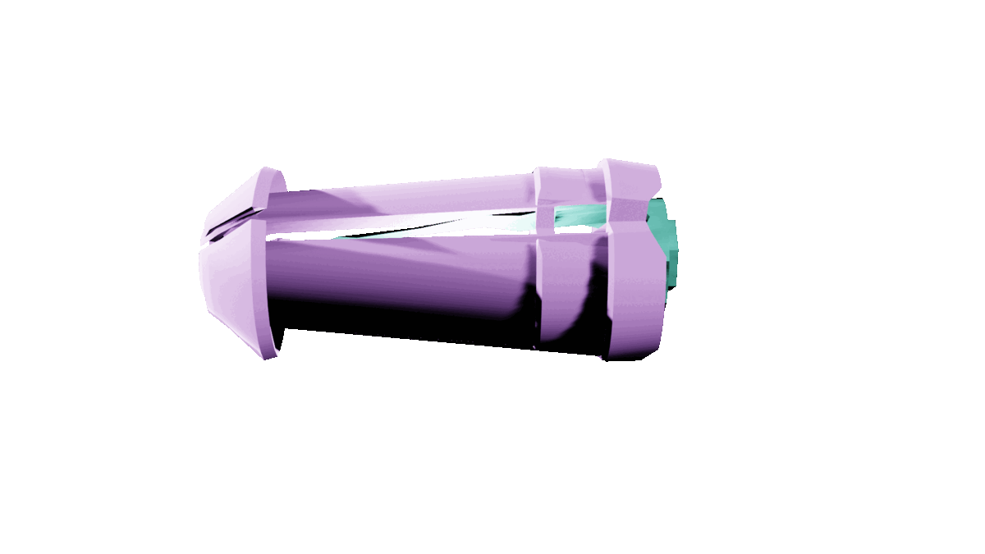


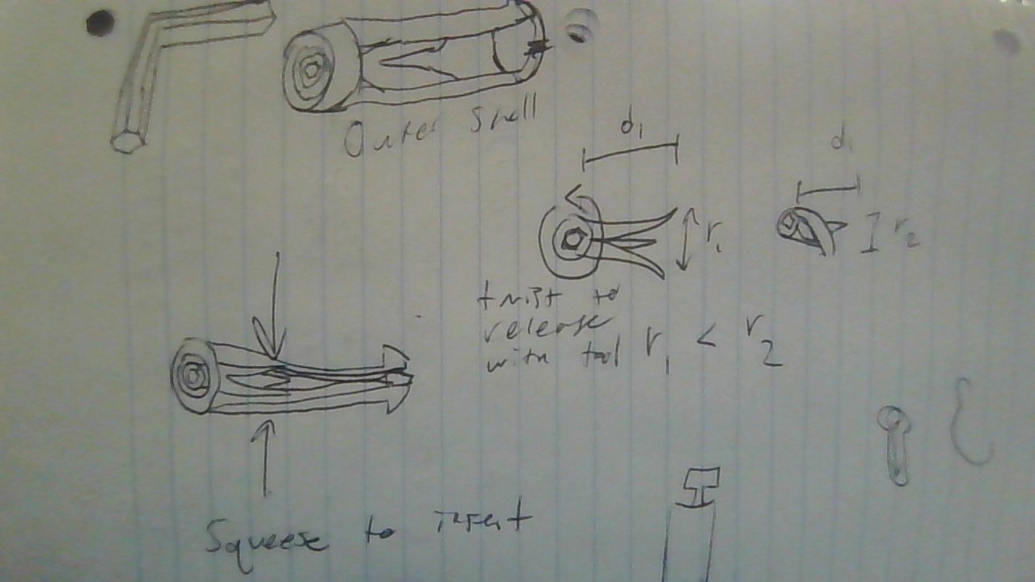

Product Overview
Mechanics
Similar To… but
Easy access insert allows for easy installation and simple disassembly
Screw
Nail
Novel Concept
Utilizes a unique release mechanism of internal twisting to reduce the radius of the Fastener reducing the friction holding it in place

Slide 6
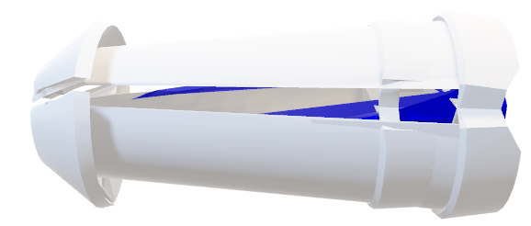
Product Overview
Mechanics
Similar To… but
Easy access insert allows for easy installation and simple disassembly
Screw
Nail
Novel Concept
Utilizes a unique release mechanism of internal twisting to reduce the radius of the Fastener End

Slide 7
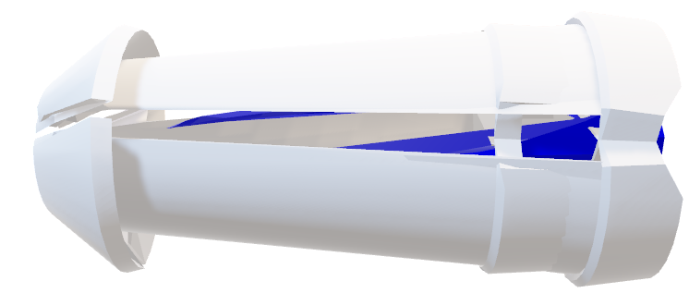
Product Benefits

Slide 8

Product Benefits

Slide 9
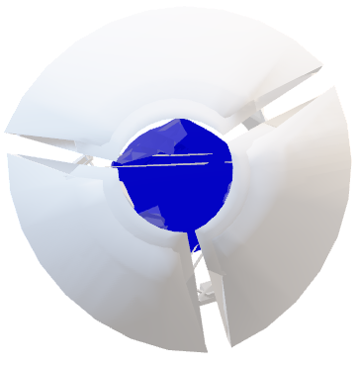
Product Benefits

Slide 10
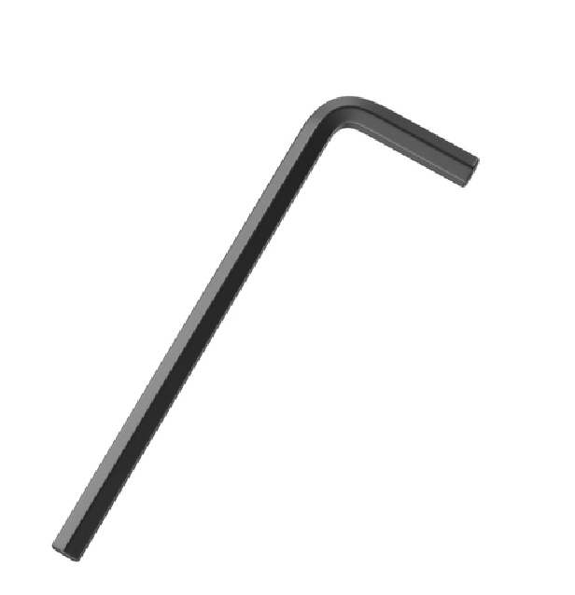
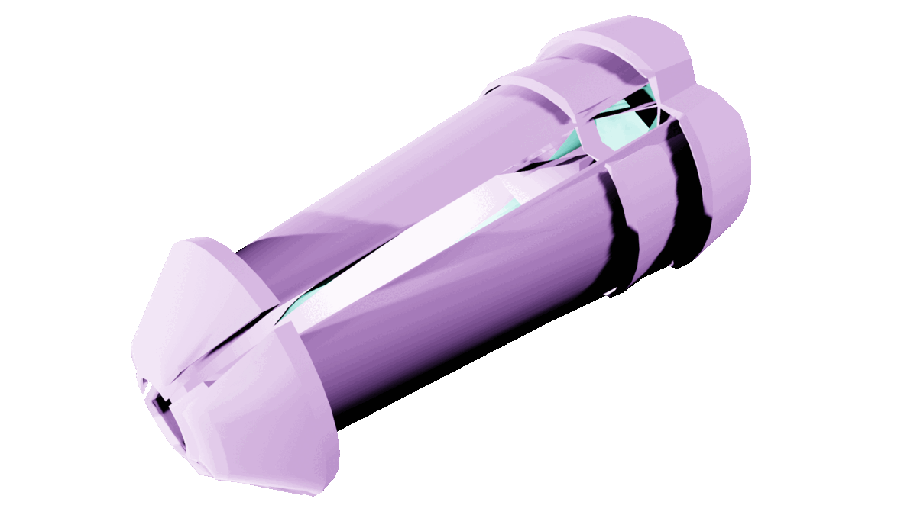
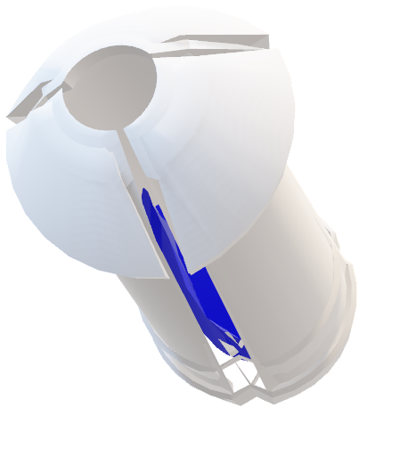
Product Benefits

Slide 11
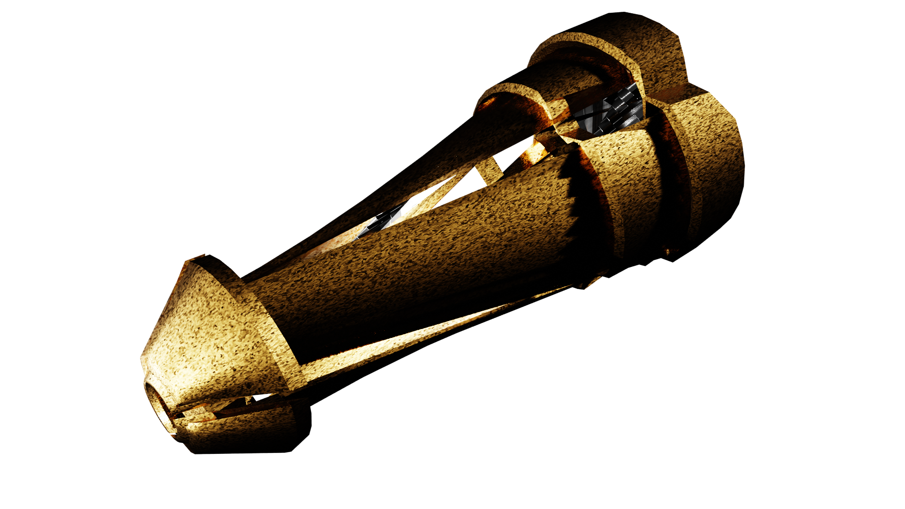
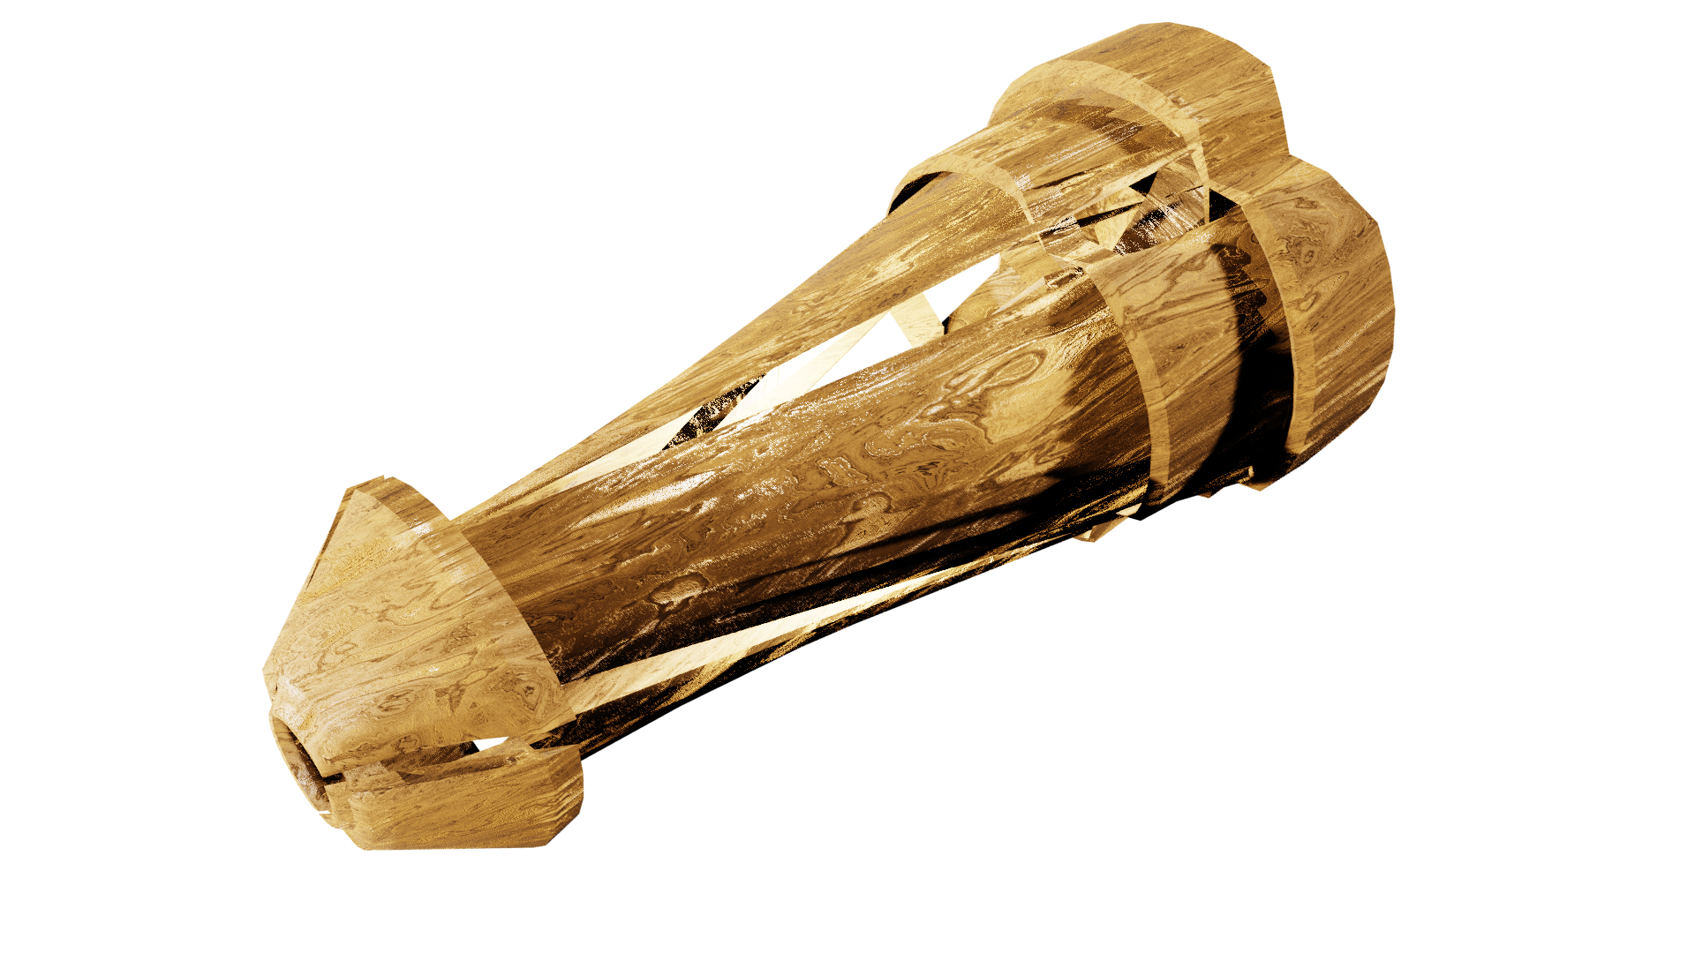
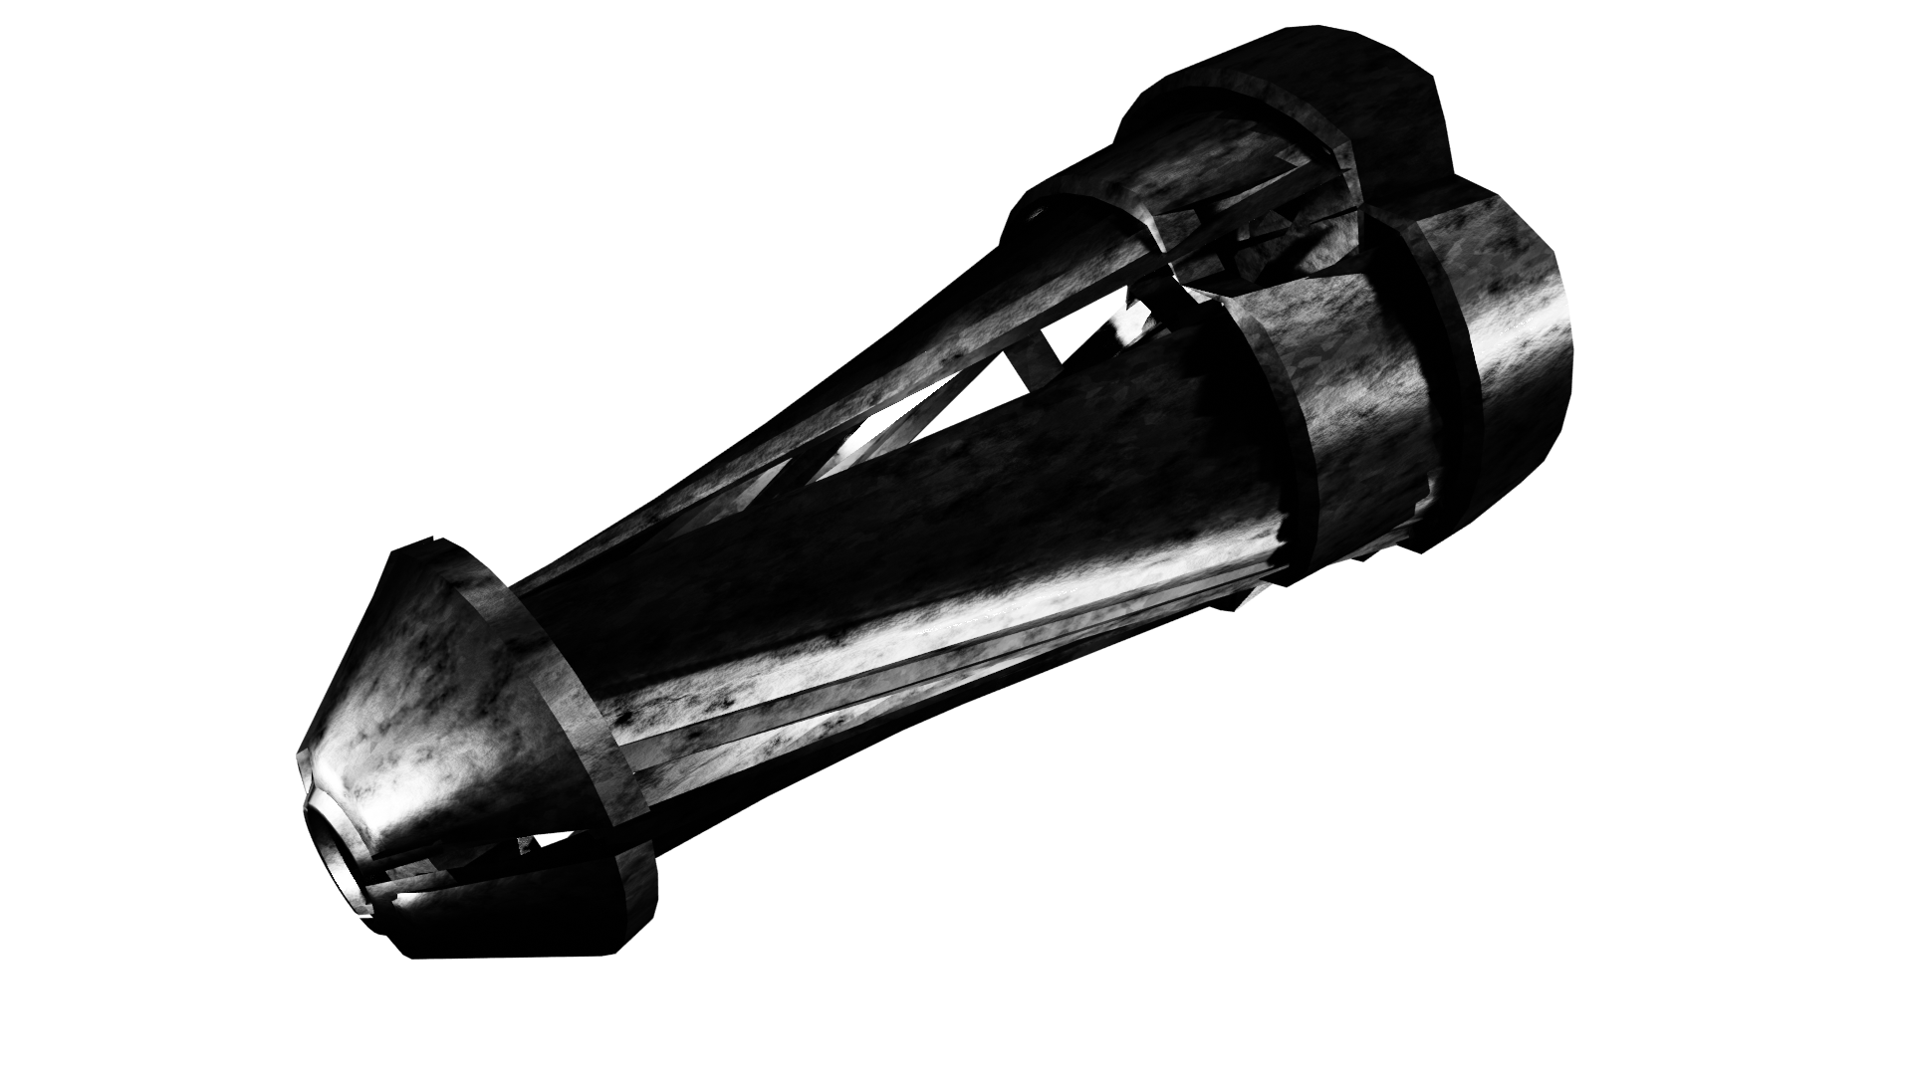
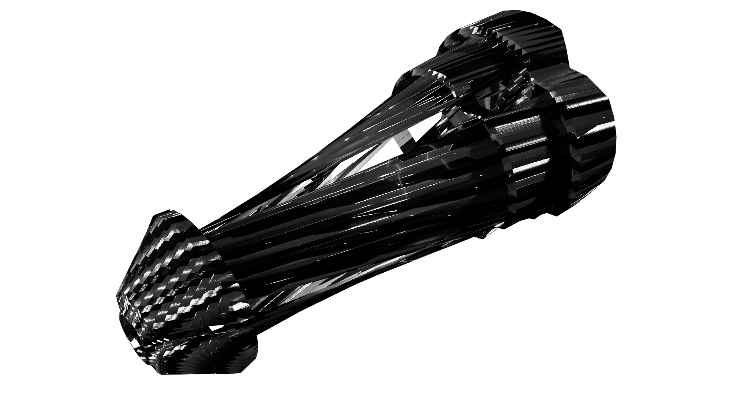
Luxury Models
Solid Gold
Handcrafted Wood
Carbon Fiber
Galvanized Steel

Slide 12
Prevention Stickers

Slide 13
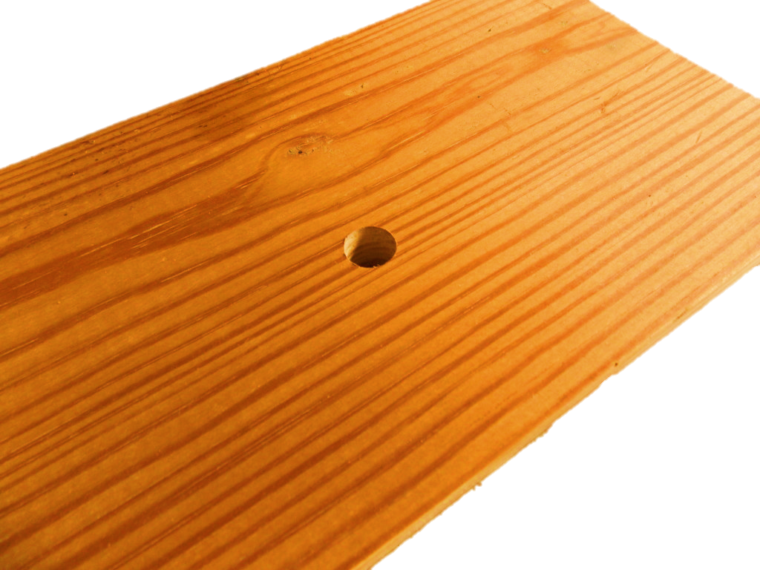

Prevention Stickers

Slide 14
Sticker Detail
Numbered by order
Transfer Stickers
Heat resistant adhesive

Slide 15
Thank you
Questions?

